Slide 1





substellar companions around b & A STARS
Kiera Charley
Arizona State University
Dr. Jennifer Patience

Slide 2
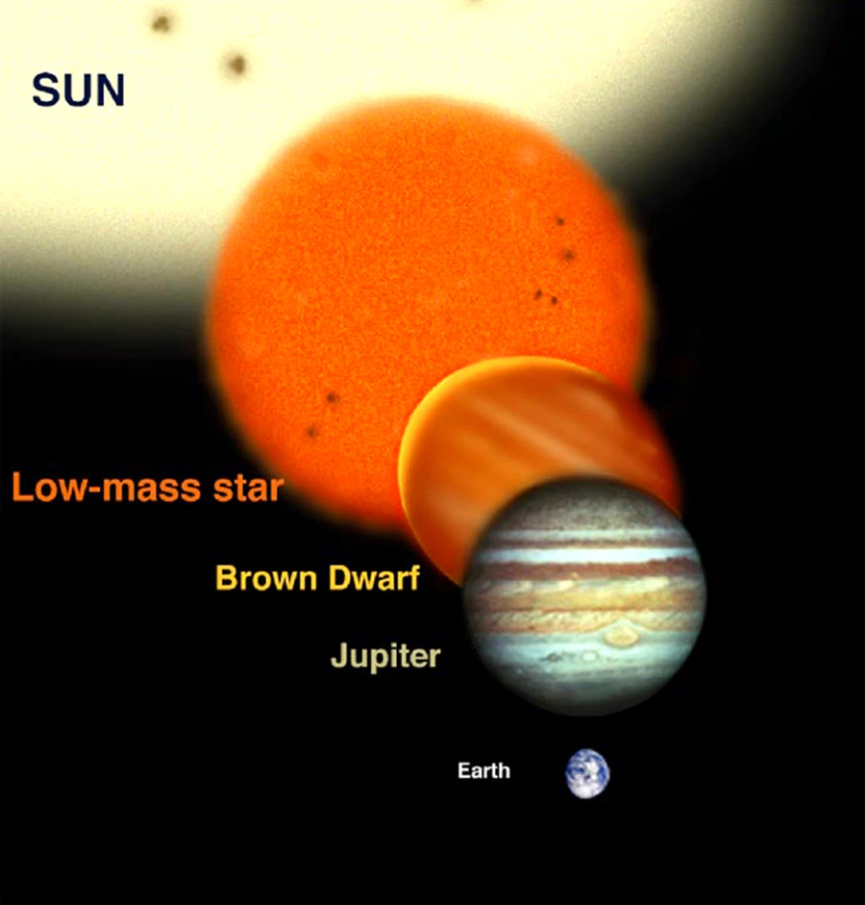
what are substellar companions?
Lomberg J., 2004

Slide 3
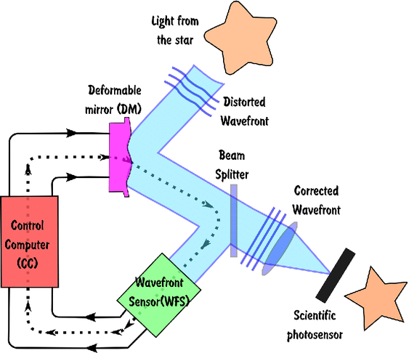
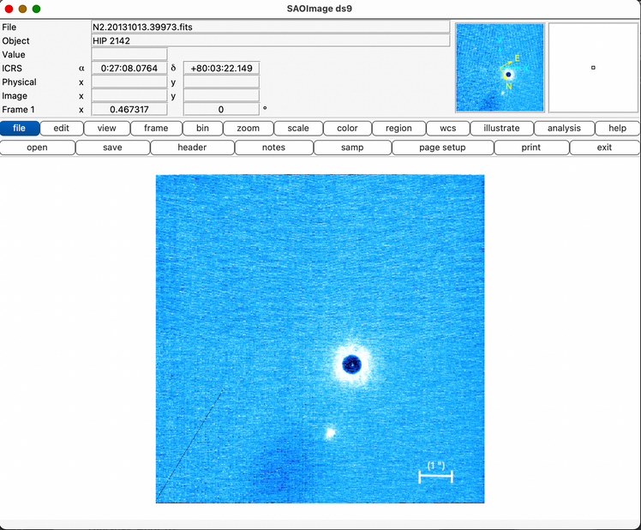
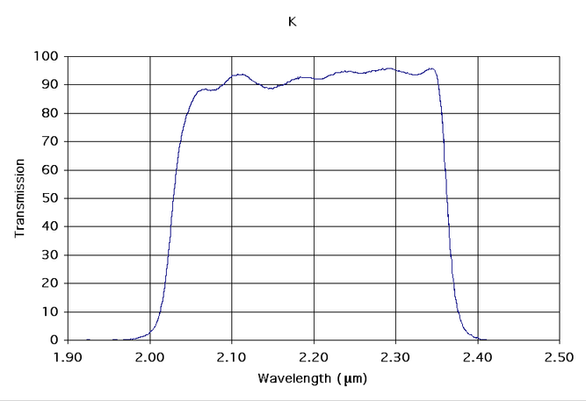
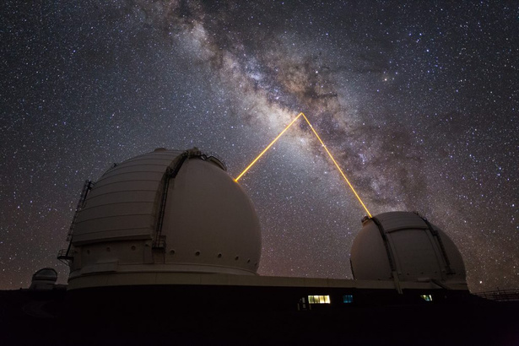
Viewing the images
Konnick, 2013
W.M. Keck Observatory
SAO DS9
W.M. Keck Observatory

Slide 4
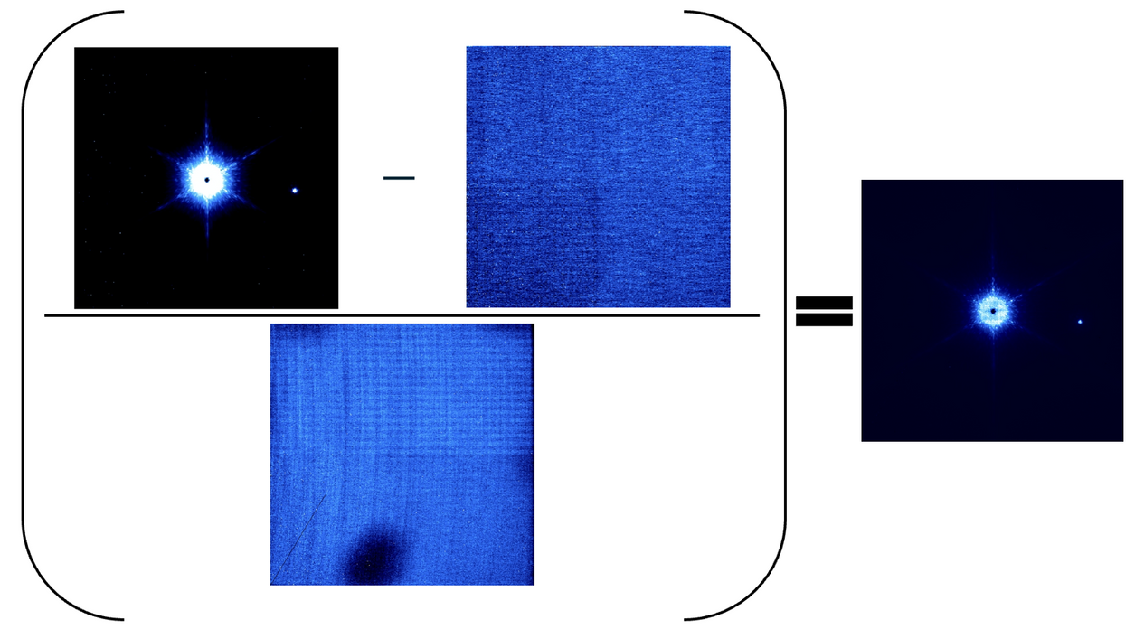

image correction PROCESS

Slide 5
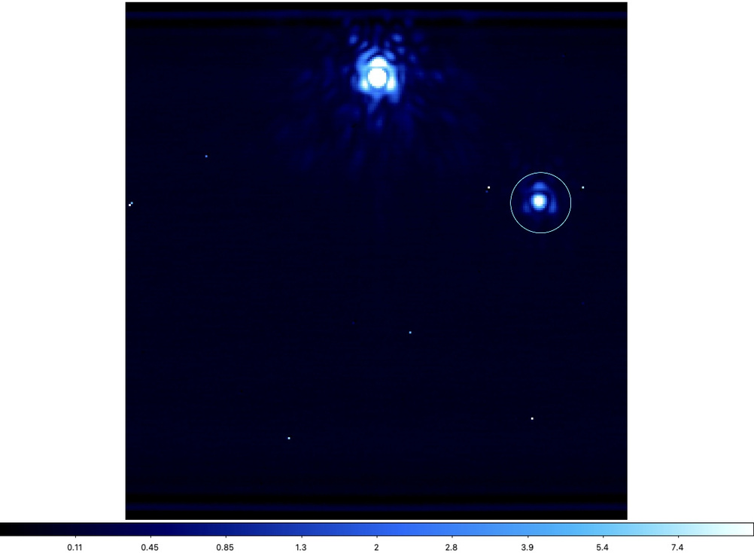
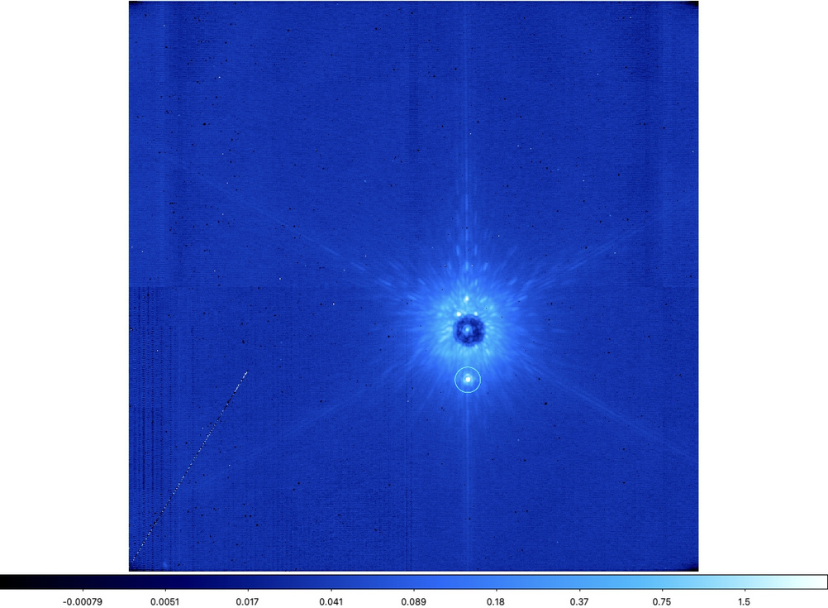
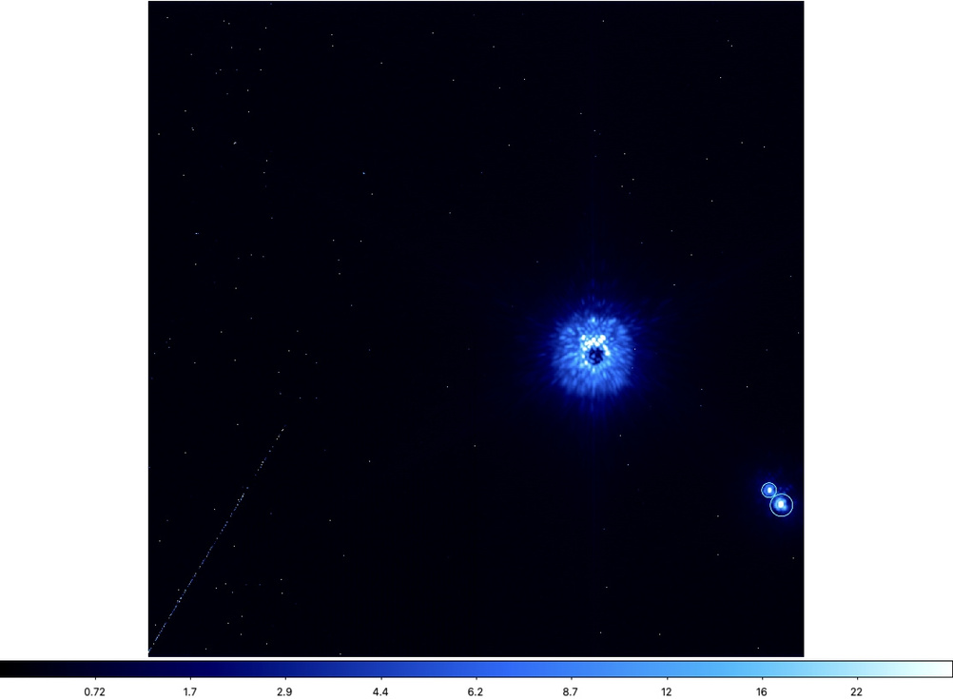
companions found
HIP 18217
HIP 22842
HIP 117452

Slide 6
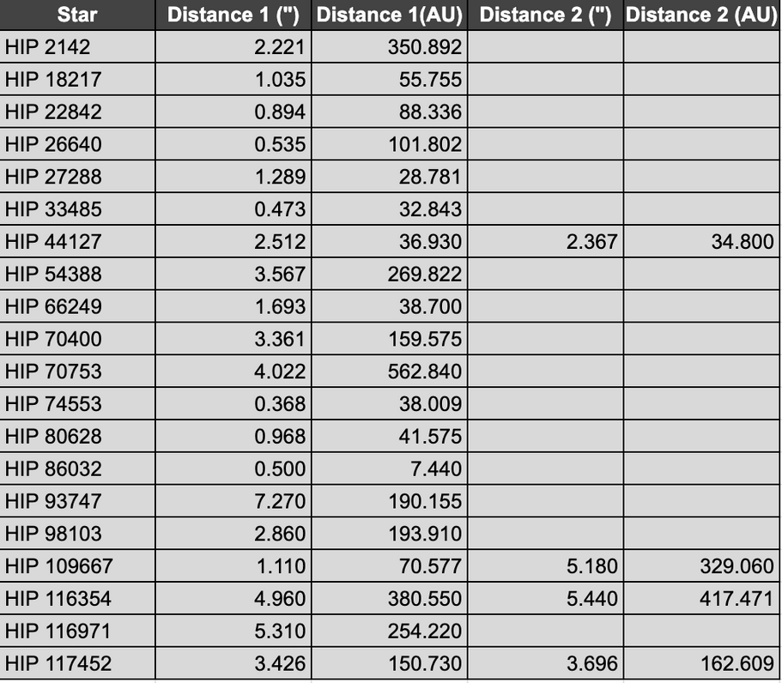
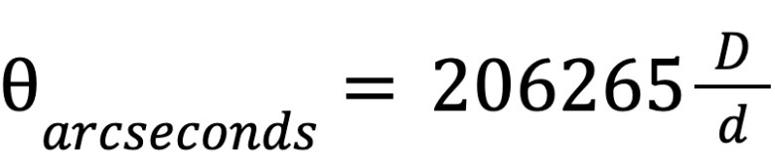
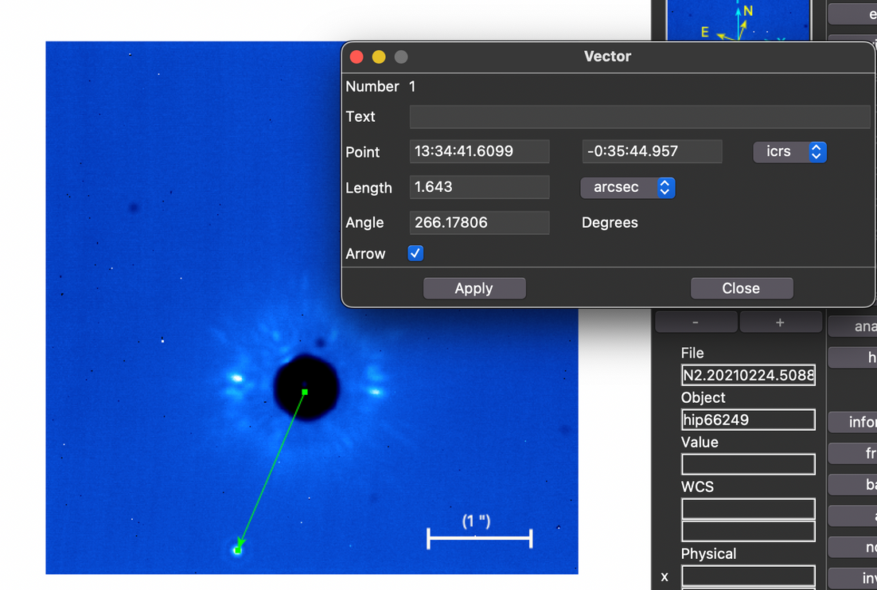
separation estimations
SAO DS9

Slide 7

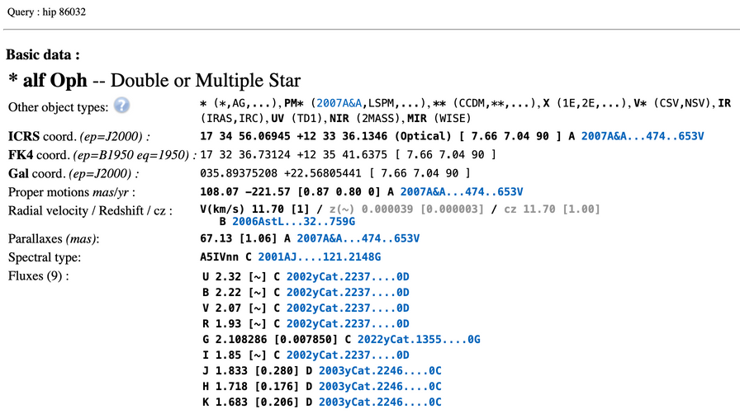

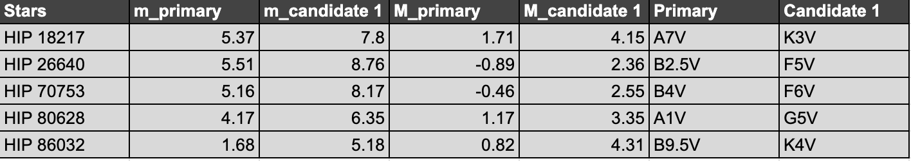
spectral type estimations
The SIMBAD astronomical database

Slide 8
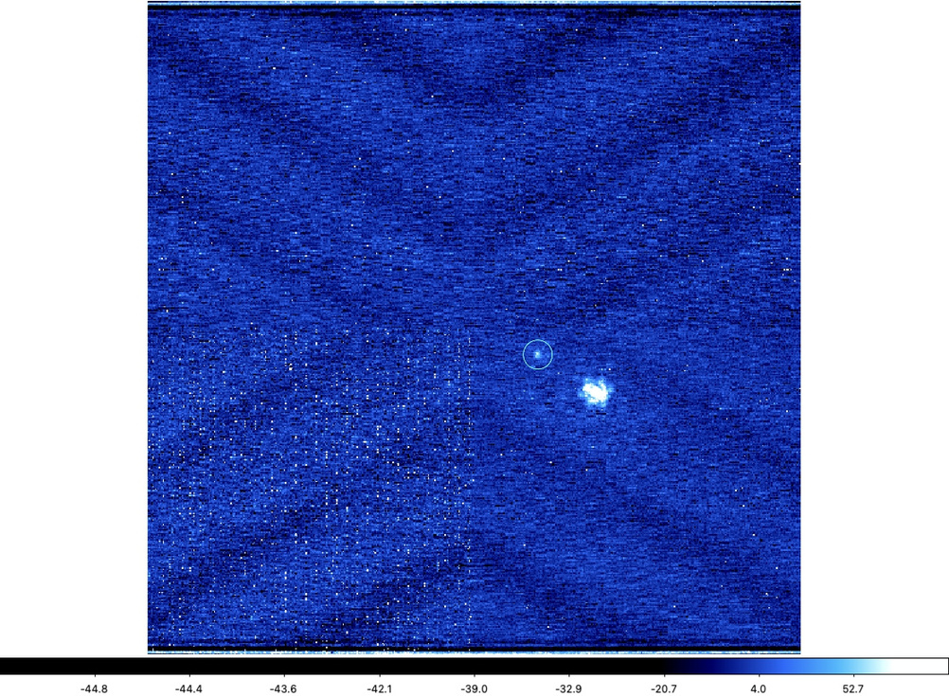
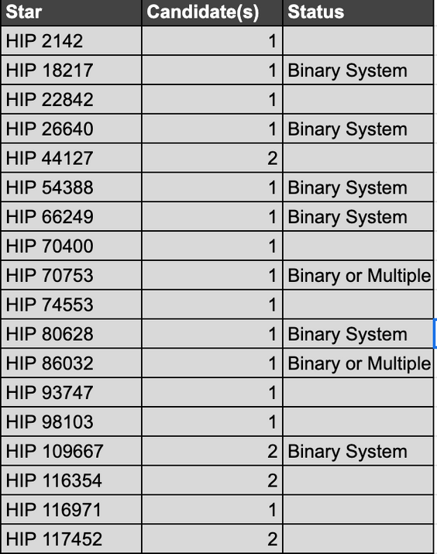
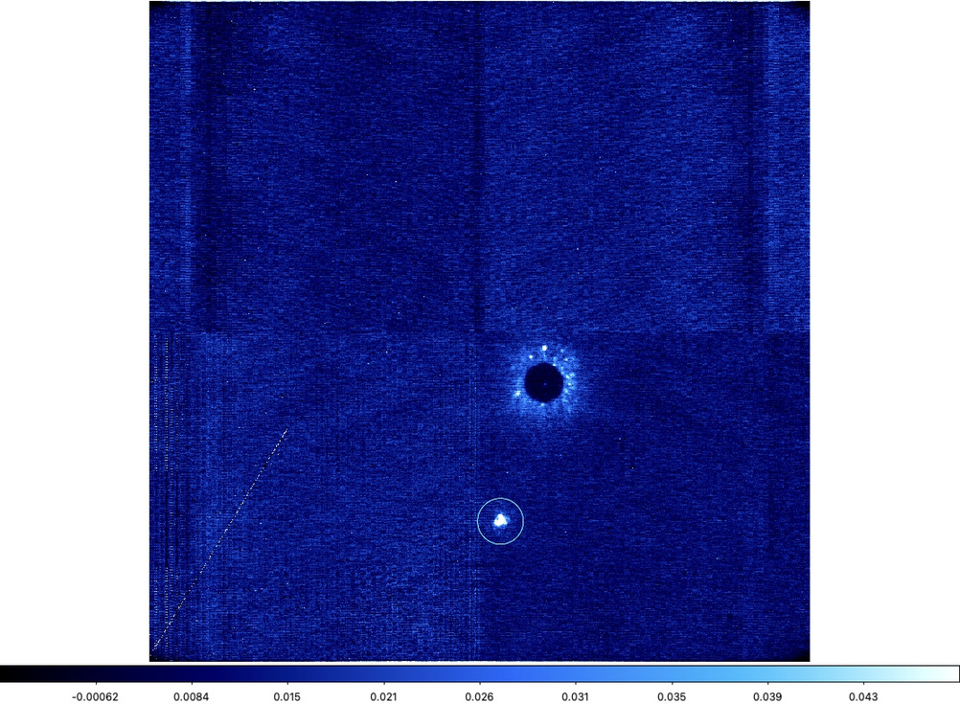
Conclusion
HIP 26640
HIP 2142

Slide 9
Thank You
kjcharle@asu.edu
ky.ly9311@gmail.com

